Slide 1
Chapter 4:
Making Decisions

Slide 2
4.1
Relational Operators

Slide 3
Relational Operators
Used to compare numbers to determine relative order
Operators:
> | Greater than
< | Less than
>= | Greater than or equal to
<= | Less than or equal to
== | Equal to
!= | Not equal to

Slide 4
Relational Expressions
Boolean expressions – true or false
Examples:
  12 > 5 is true
  7 <= 5 is false
  if x is 10, then
  x == 10 is true,
  x != 8 is true, and
  x == 8 is false

Slide 5
Relational Expressions
Can be assigned to a variable:
  result = x <= y;
Assigns 0 for false, 1 for true
Do not confuse = and ==

Slide 6
4.2
The if Statement

Slide 7
The if Statement
Allows statements to be conditionally executed or skipped over
Models the way we mentally evaluate situations:
  "If it is raining, take an umbrella."
  "If it is cold outside, wear a coat."

Slide 8
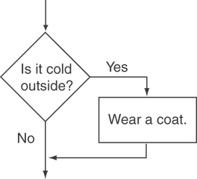
Flowchart for Evaluating a Decision

Slide 9
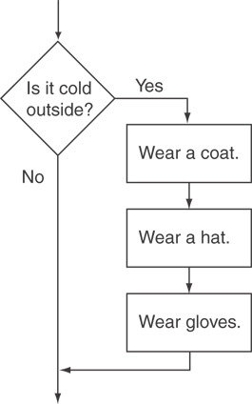
Flowchart for Evaluating a Decision

Slide 10
The if Statement
General Format:
  if (expression)
  statement;

Slide 11
The if Statement-What Happens
To evaluate:
  if (expression)
  statement;
If the expression is true, then statement is executed.
If the expression is false, then statement is skipped.

Slide 12
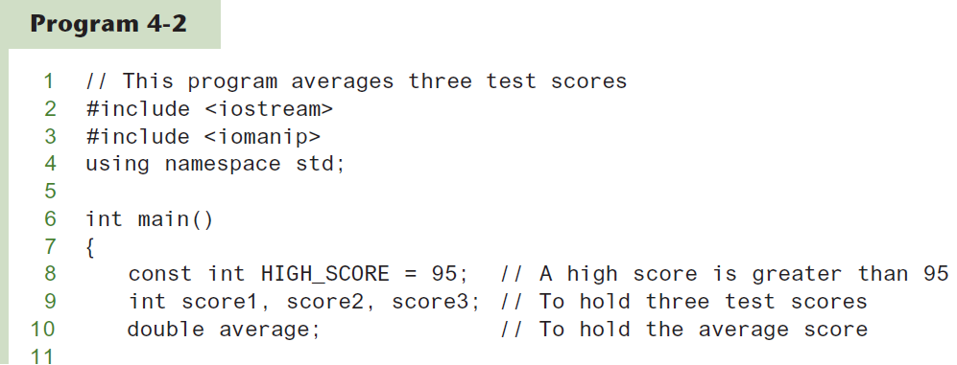
if Statement
Continued…

Slide 13
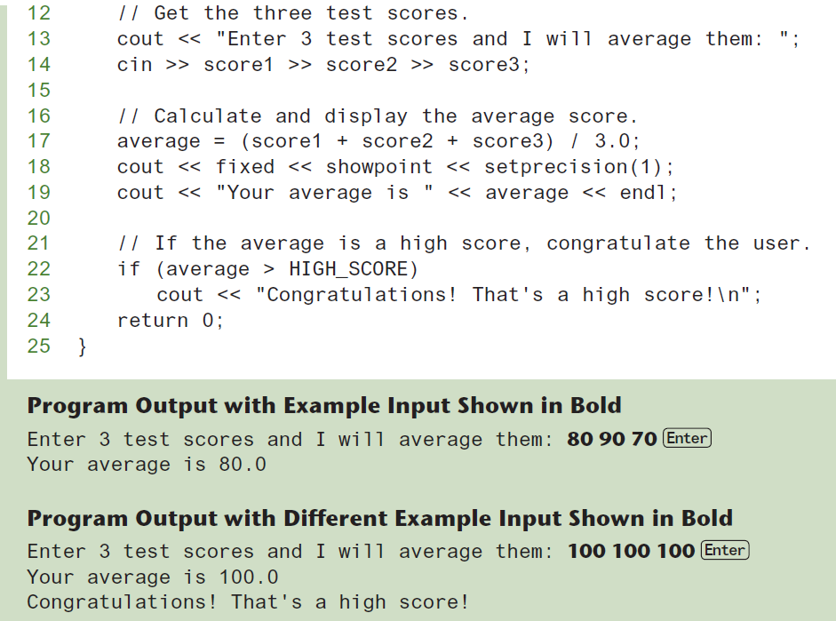
if Statement

Slide 14
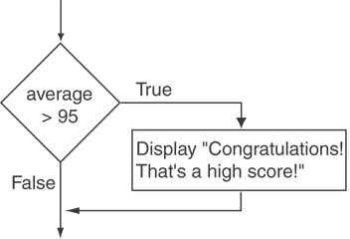
Flowchart for Program 4-2 Lines 22 and 23

Slide 15
if Statement Notes
Do not place ; after (expression)
Place statement; on a separate line after (expression), indented:
  if (score > 90)
  grade = 'A';
Be careful testing floats and doubles for equality
0 is false; any other value is true

Slide 16
4.3
Expanding the if Statement

Slide 17
Expanding the if Statement
To execute more than one statement as part of an if statement, enclose them in { }:
  if (score > 90)
  {
  grade = 'A';
  cout << "Good Job!\n";
  }
{ } creates a block of code

Slide 18
4.4
The if/else Statement

Slide 19
The if/else statement
Provides two possible paths of execution
Performs one statement or block if the expression is true, otherwise performs another statement or block.

Slide 20
The if/else statement
General Format:
  if (expression)
  statement1; // or block
  else
  statement2; // or block

Slide 21
if/else-What Happens
To evaluate:
  if (expression)
  statement1;
  else
  statement2;
If the expression is true, then statement1 is executed and statement2 is skipped.
If the expression is false, then statement1 is skipped and statement2 is executed.

Slide 22
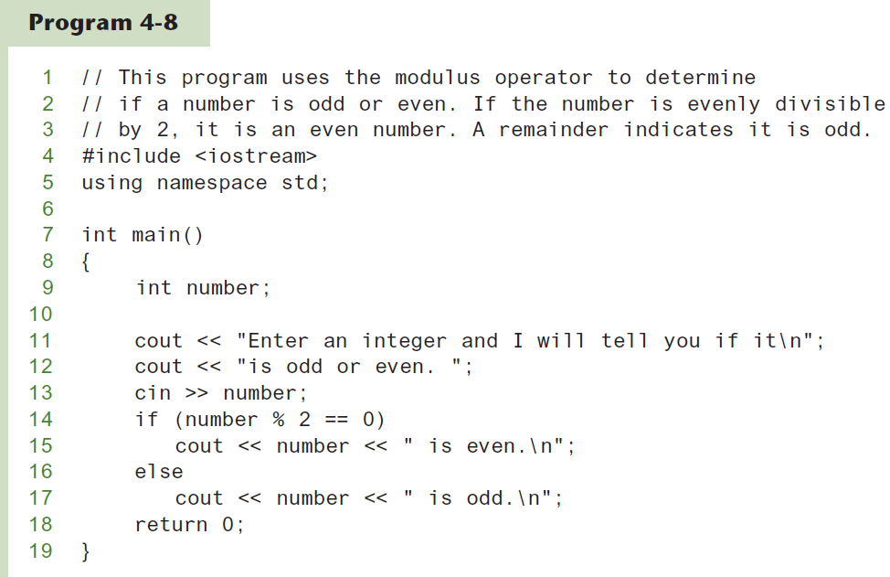
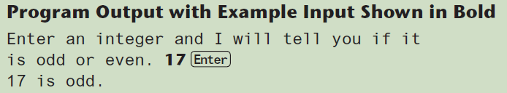
The if/else statement and Modulus Operator

Slide 23
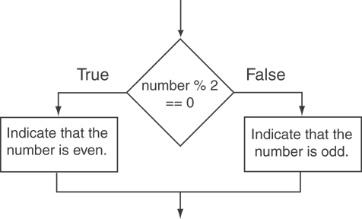
Flowchart for Program 4-8 Lines 14 through 18

Slide 24
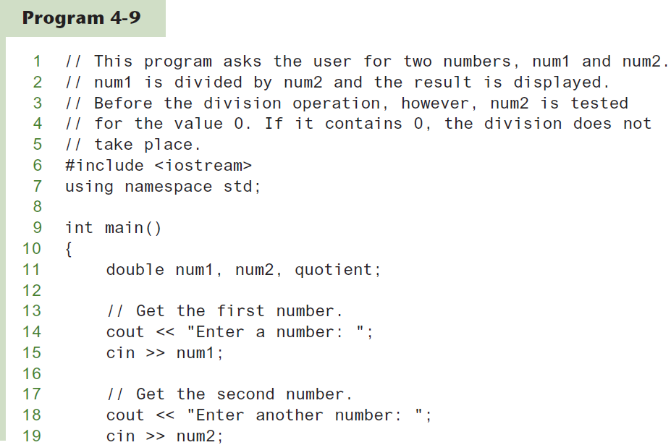
Testing the Divisor in Program 4-9
Continued…

Slide 25
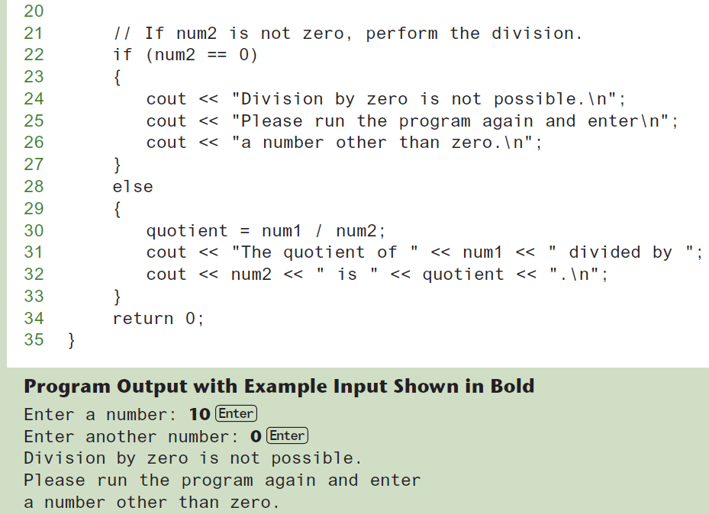
Testing the Divisor in Program 4-9

Slide 26
4.5
Nested if Statements

Slide 27
Nested if Statements
An if statement that is nested inside another if statement
Nested if statements can be used to test more than one condition

Slide 28
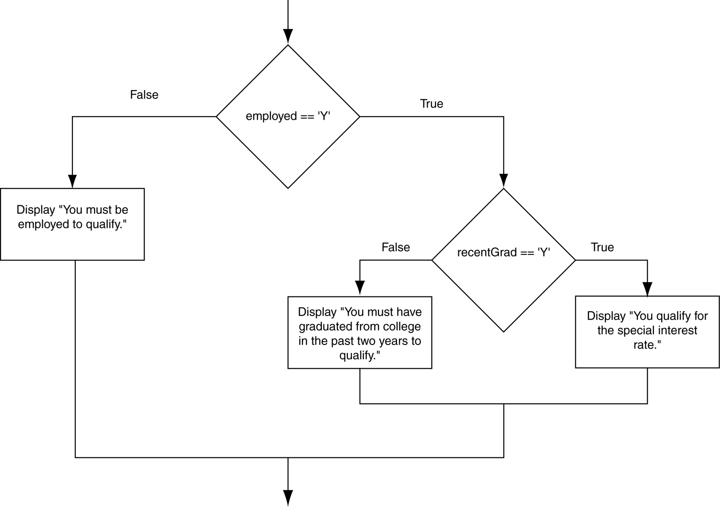
Flowchart for a Nested if Statement

Slide 29
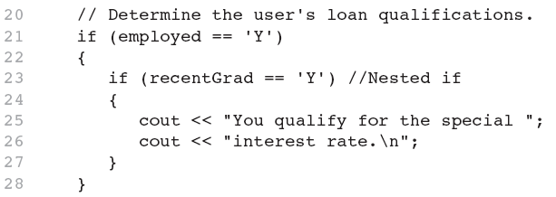
Nested if Statements
From Program 4-10

Slide 30
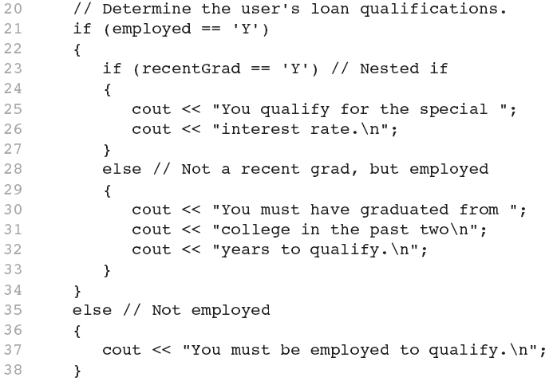
Nested if Statements
Another example, from Program 4-11

Slide 31
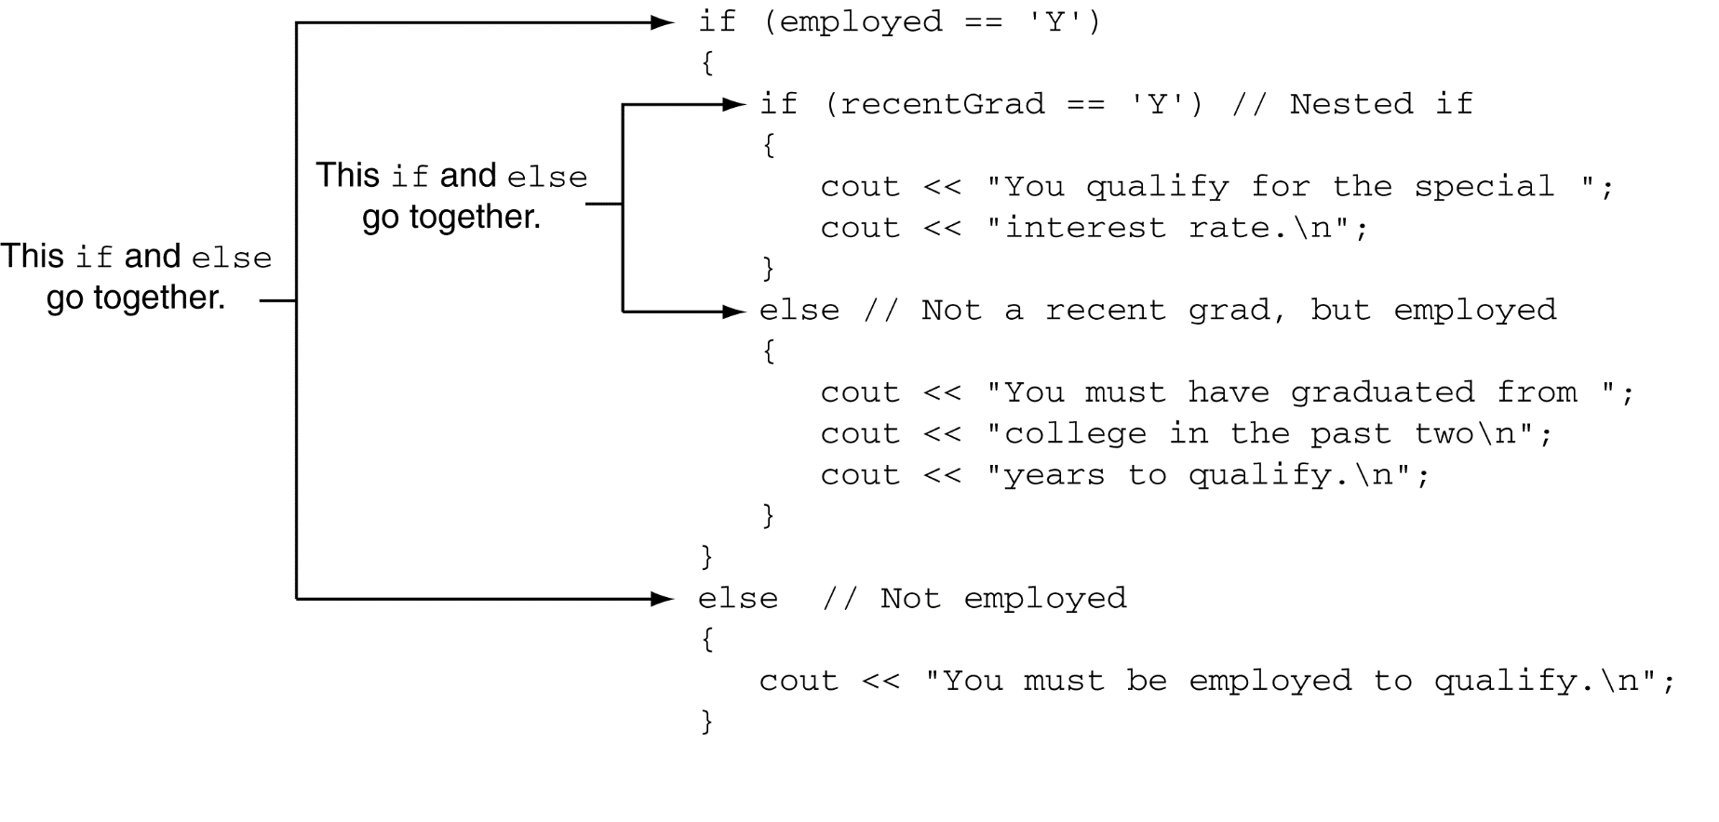
Use Proper Indentation!

Slide 32
4.6
The if/else if Statement

Slide 33
The if/else if Statement
Tests a series of conditions until one is found to be true
Often simpler than using nested if/else statements
Can be used to model thought processes such as:
"If it is raining, take an umbrella,
else, if it is windy, take a hat,
else, take sunglasses”

Slide 34
if/else if Format
  if (expression)
  statement1; // or block
  else if (expression)
  statement2; // or block
  .
  . // other else ifs .
  else if (expression)
  statementn; // or block

Slide 35
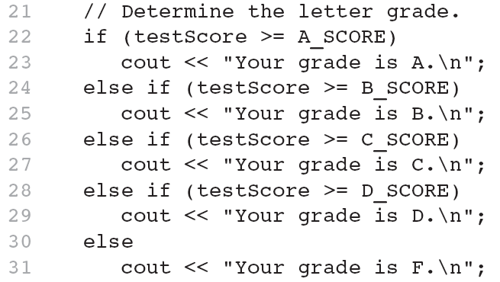
The if/else if Statement in Program 4-13

Slide 36
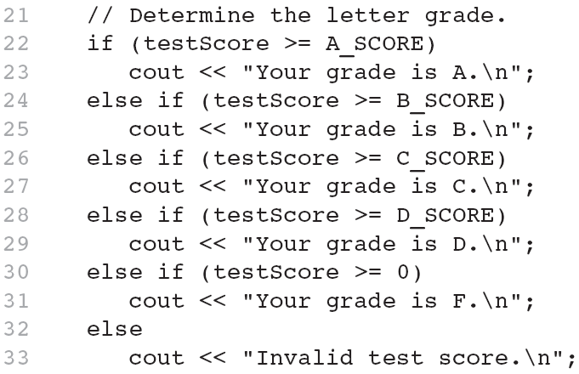
Using a Trailing else to Catch Errors in Program 4-14
The trailing else clause is optional, but it is best used to catch errors.
This trailing else catches invalid test scores

Slide 37
4.7
The if Statement with Initialization

Slide 38
if Statement Initialization
A feature introduced in C++17
if statements can have an optional initialization clause that is executed before the conditional expression is evaluated
General format:
if (initialization; expression)
{
statement;
statement;
// Place as many statements here as necessary.
}

Slide 39
if Statement Initialization
General format of if-else with initialization:
if (initialization; expression)
{
statement;
statement;
// Place as many statements here as necessary.
}
else
{
statement;
statement;
// Place as many statements here as necessary.
}

Slide 40
if Statement Initialization
Example:
if (int len = password.length(); len < MIN_LENGTH)
{
cout << "Your password is too short." << endl;
}
else
{
cout << "Your password has " << len
<< " characters." << endl;
}

Slide 41
4.8
Flags

Slide 42
Flags
Variable that signals a condition
Usually implemented as a bool variable
Can also be an integer
  The value 0 is considered false
  Any nonzero value is considered true
As with other variables in functions, must be assigned an initial value before it is used

Slide 43
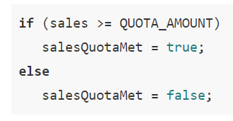
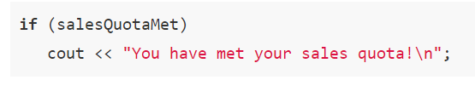
Example

Slide 44
4.9
Logical Operators

Slide 45
Logical Operators
Used to create relational expressions from other relational expressions
Operators, meaning, and explanation:
&& | AND | New relational expression is true if both expressions are true
|| | OR | New relational expression is true if either expression is true
! | NOT | Reverses the value of an expression – true expression becomes false, and false becomes true

Slide 46
Logical Operators-Examples
int x = 12, y = 5, z = -4;
(x > y) && (y > z)
(x > y) && (z > y)
(x <= z) || (y == z)
(x <= z) || (y != z)
!(x >= z)

Slide 47
Logical Operators-Examples
int x = 12, y = 5, z = -4;
(x > y) && (y > z) | true
(x > y) && (z > y) | false
(x <= z) || (y == z) | false
(x <= z) || (y != z) | true
!(x >= z) | false

Slide 48
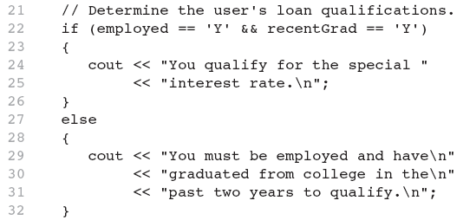
The logical && operator in Program 4-15

Slide 49
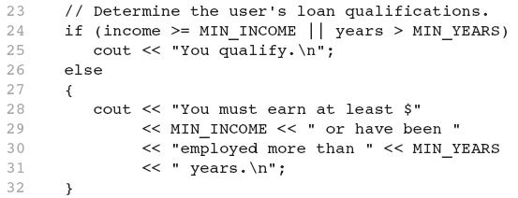
The logical || Operator in Program 4-16

Slide 50
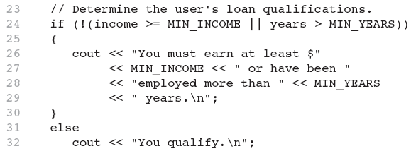
The logical ! Operator in Program 4-17

Slide 51
Logical Operator-Notes
! has highest precedence, followed by &&, then ||
If the value of an expression can be determined by evaluating just the sub-expression on left side of a logical operator, then the sub-expression on the right side will not be evaluated (short circuit evaluation)

Slide 52
4.10
Checking Numeric Ranges with Logical Operators

Slide 53
Checking Numeric Ranges with Logical Operators
Used to test to see if a value falls inside a range:
  if (grade >= 0 && grade <= 100)
  cout << "Valid grade";
Can also test to see if value falls outside of range:
  if (grade <= 0 || grade >= 100)
  cout << "Invalid grade";
Cannot use mathematical notation:
  if (0 <= grade <= 100) //doesn’t work!

Slide 54
APPLICATIONS OF CONDITIONAL STATEMENTS
Menu
Input Validations

Slide 55
APPLICATIONS OF CONDITIONAL STATEMENTS
Menu
Input Validations

Slide 56
4.11
Menus

Slide 57
Menus
Menu-driven program: program execution controlled by user selecting from a list of actions
Menu: list of choices on the screen
Menus can be implemented using if/else if statements

Slide 58
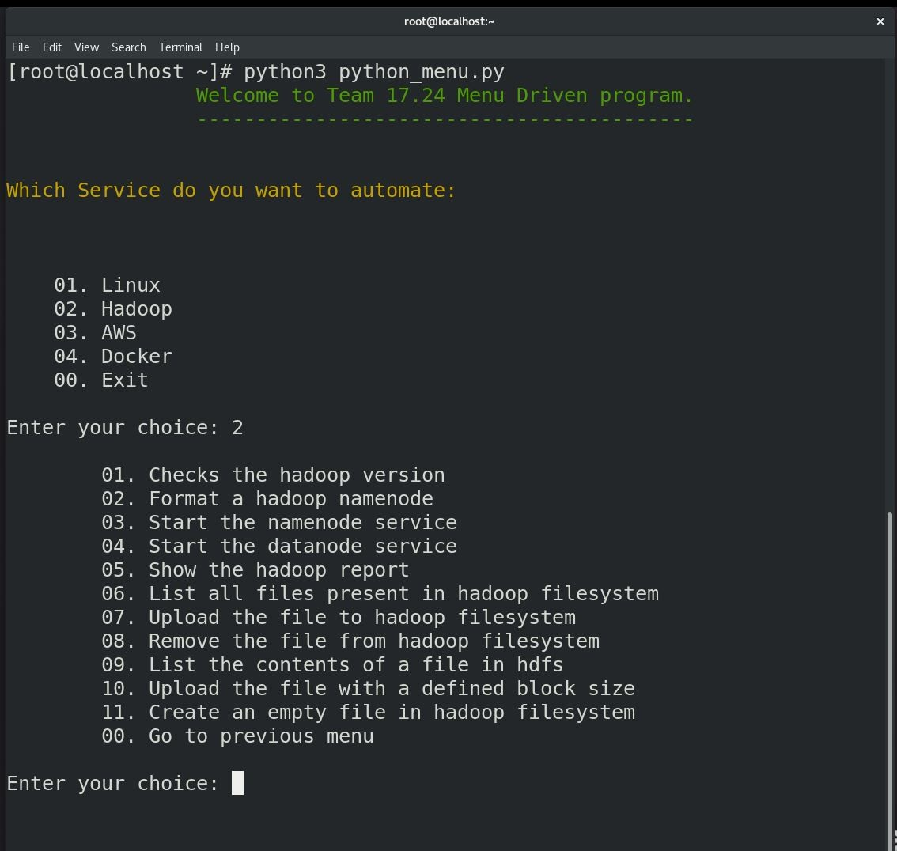
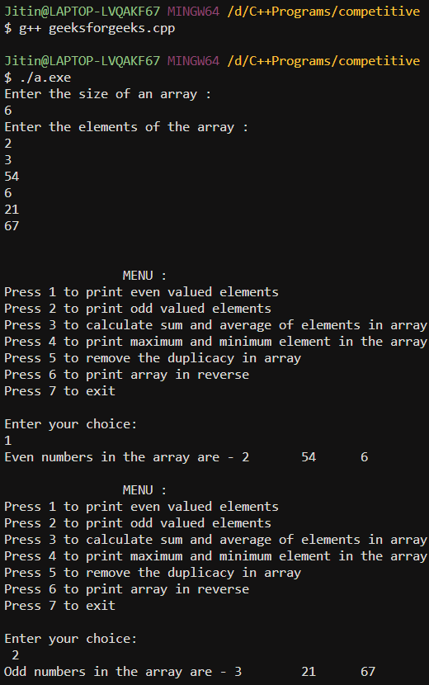

Slide 59
Menu-Driven Program Organization
Display list of numbered or lettered choices for actions
Prompt user to make selection
Test user selection in expression
  if a match, then execute code for action
  if not, then go on to next expression
Program 4-18

Slide 60
APPLICATIONS OF CONDITIONAL STATEMENTS
Menu
Input Validations

Slide 61
4.12
Validating User Input

Slide 62
Validating User Input
Input validation: inspecting input data to determine whether it is acceptable
Bad output will be produced from bad input
Can perform various tests:
  Range
  Reasonableness
  Valid menu choice
  Divide by zero

Slide 63
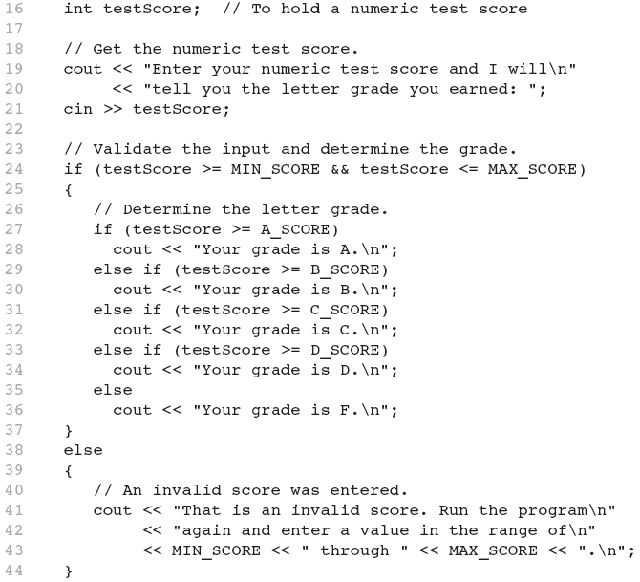
Input Validation in Program 4-19

Slide 64
4.13
Comparing Characters and Strings

Slide 65
Comparing Characters
Characters are compared using their ASCII values
'A' < 'B'
  The ASCII value of 'A' (65) is less than the ASCII value of 'B'(66)
'1' < '2'
  The ASCII value of '1' (49) is less than the ASCI value of '2' (50)
Lowercase letters have higher ASCII codes than uppercase letters, so 'a' > 'Z'

Slide 66
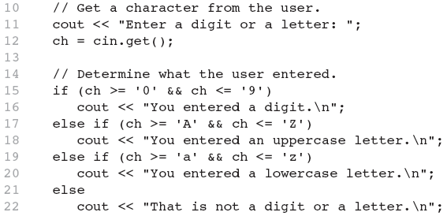
Relational Operators Compare Characters in Program 4-20

Slide 67
Comparing string Objects
Like characters, strings are compared using their ASCII values
string name1 = "Mary";
string name2 = "Mark";
The characters in each string must match before they are equal
name1 > name2 // true
name1 <= name2 // false
name1 != name2 // true
name1 < "Mary Jane" // true

Slide 68
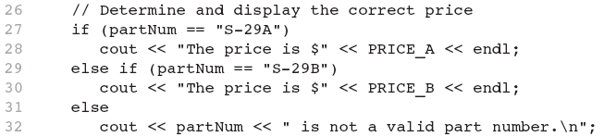
Relational Operators Compare Strings in Program 4-21

Slide 69
4.14
The Conditional Operator

Slide 70
The Conditional Operator
Can use to create short if/else statements
Format: expr ? expr : expr;
x<0 ? y=10 : z=20;
First Expression:
Expression to be
tested
2nd Expression:
Executes if first
expression is true
3rd Expression:
Executes if the first
expression is false

Slide 71
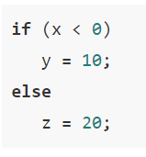

Example

Slide 72
The Conditional Operator
The value of a conditional expression is
  The value of the second expression if the first expression is true
  The value of the third expression if the first expression is false
Parentheses () may be needed in an expression due to precedence of conditional operator

Slide 73
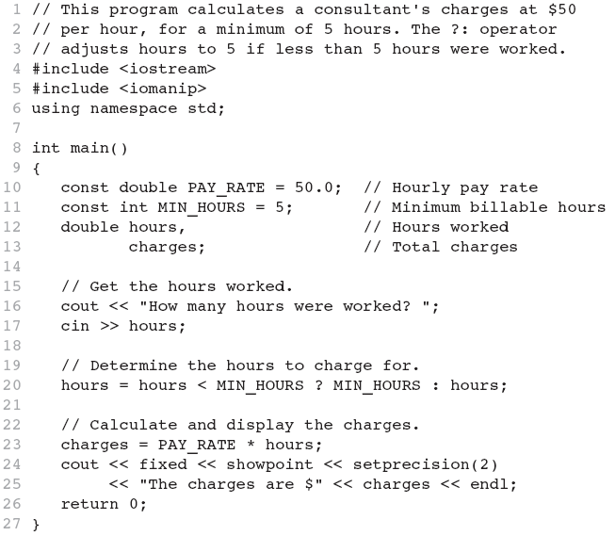
The Conditional Operator in Program 4-22

Slide 74
4.15
The switch Statement

Slide 75
The switch Statement
Used to select among statements from several alternatives
In some cases, can be used instead of if/else if statements

Slide 76
switch Statement Format
switch (expression) //integer
{
case exp1: statement1;
case exp2: statement2;
...
case expn: statementn;
default: statementn+1;
}

Slide 77
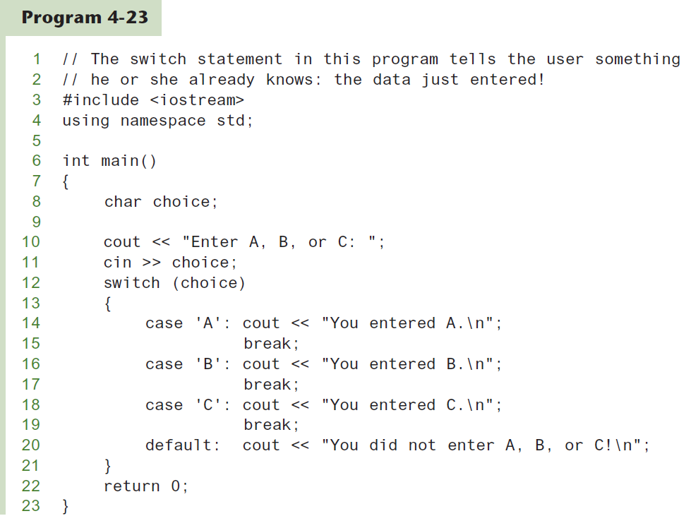
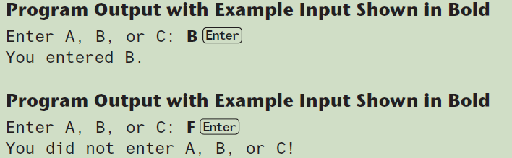
The switch Statement

Slide 78
switch Statement Requirements
1) expression must be an integer variable or an expression that evaluates to an integer value
exp1 through expn must be constant integer expressions or literals, and must be unique in the switch statement
default is optional but recommended

Slide 79
switch Statement-How it Works
1) expression is evaluated
The value of expression is compared against exp1 through expn.
If expression matches value expi, the program branches to the statement following expi and continues to the end of the switch
If no matching value is found, the program branches to the statement after default:

Slide 80
break Statement
Used to exit a switch statement
If it is left out, the program "falls through" the remaining statements in the switch statement

Slide 81
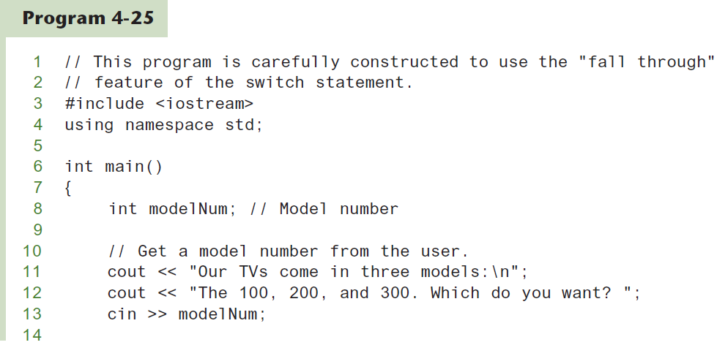
break and default statements
Continued…

Slide 82
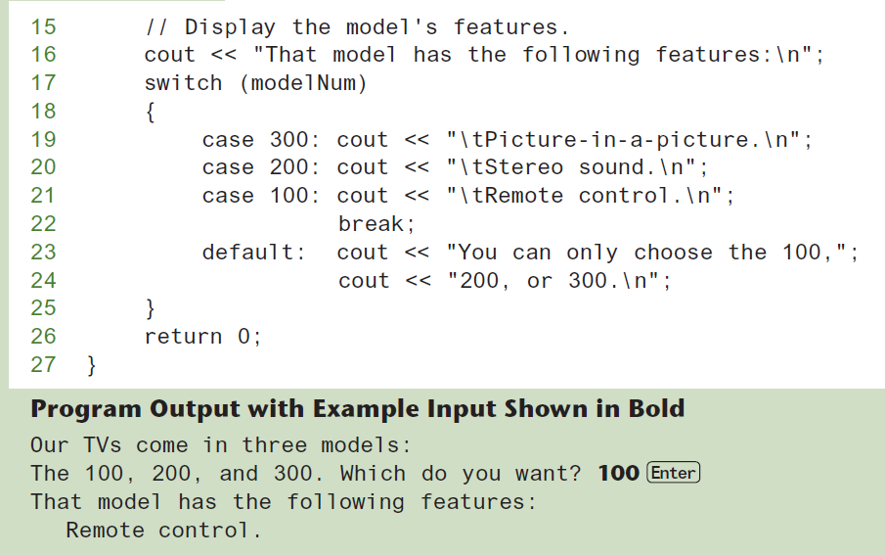
break and default statements
Continued…

Slide 83
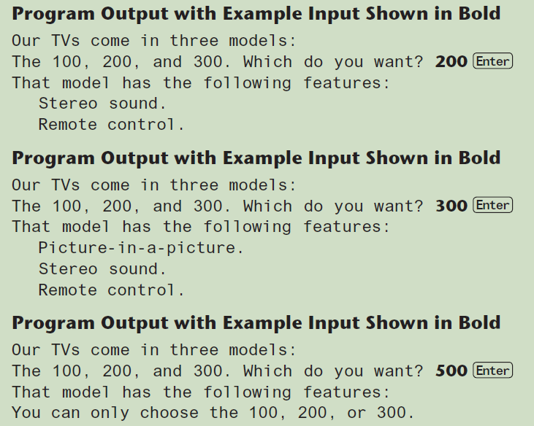
break and default statements

Slide 84
Using switch in Menu Systems
switch statement is a natural choice for menu-driven program:
  display the menu
  then, get the user's menu selection
  use user input as expression in switch statement
  use menu choices as expr in case statements

Slide 85
4.16
The switch Statement with Initialization

Slide 86
switch Statement Initialization
A feature introduced in C++17
switch statements can have an optional initialization clause that is executed before the conditional integer expression is evaluated

Slide 87
switch Statement Initialization
General format:
switch (Initialization; IntegerExpression)
{
case ConstantExpression:
// place one or more statements here
case ConstantExpression:
// place one or more statements here
// case statements may be repeated as many
// times as necessary
default:
// place one or more statements here
}

Slide 88
switch Statement Initialization
Example:
switch (int value = abs(number); value)
{
case 1:
cout << "one" << endl;
break;
case 2:
cout << "two" << endl;
break;
default:
cout << "Invalid value" << endl;
break;
}

Slide 89
4.17
More About Blocks and Scope

Slide 90
More About Blocks and Scope
Scope of a variable is the block in which it is defined, from the point of definition to the end of the block
Usually defined at beginning of function
May be defined close to first use

Slide 91
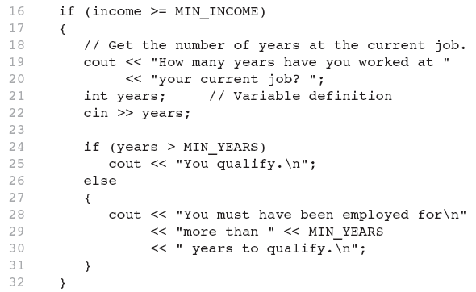
Inner Block Variable Definition in Program 4-29

Slide 92
Variables with the Same Name
Variables defined inside { } have local or block scope
When inside a block within another block, can define variables with the same name as in the outer block.
  When in inner block, outer definition is not available
  Not a good idea

Slide 93
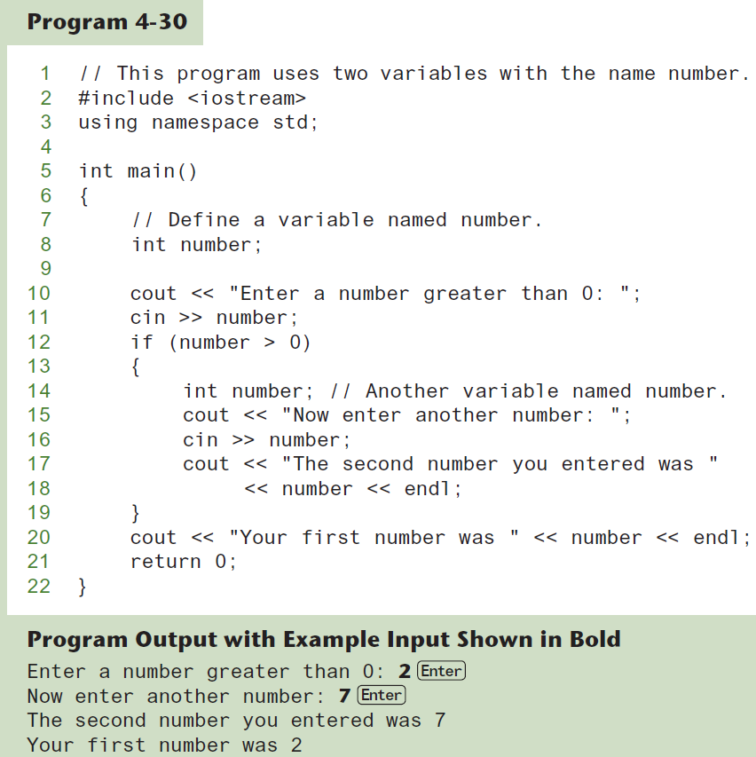
Two Variables with the Same Name

